Slide 1
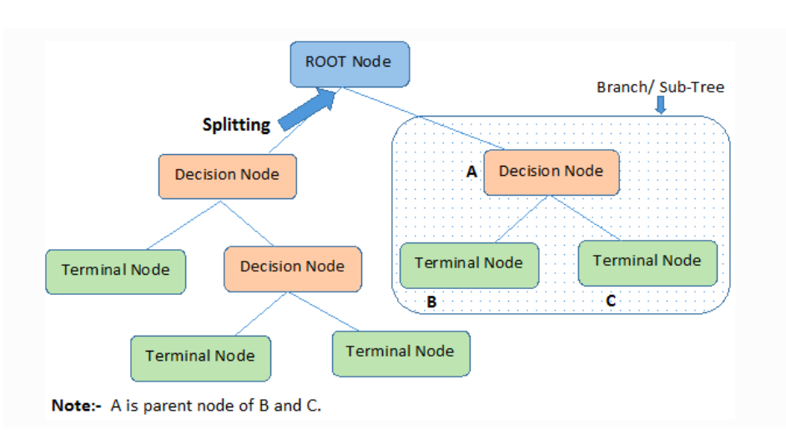
Decision Tree

Slide 2
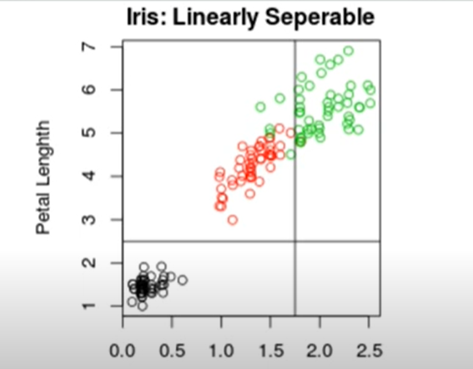
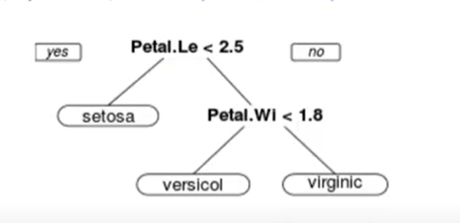
Example 1:

Slide 3
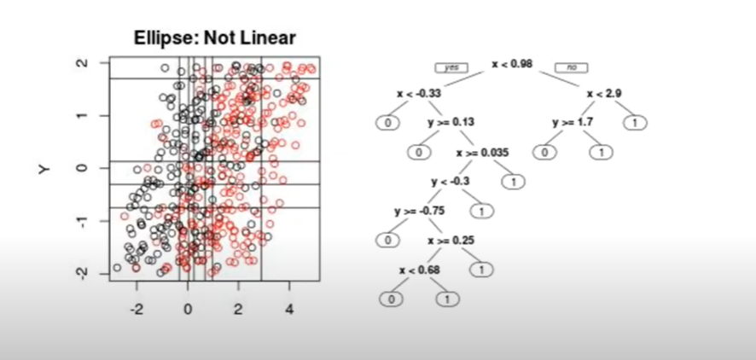
Example 2:

Slide 4
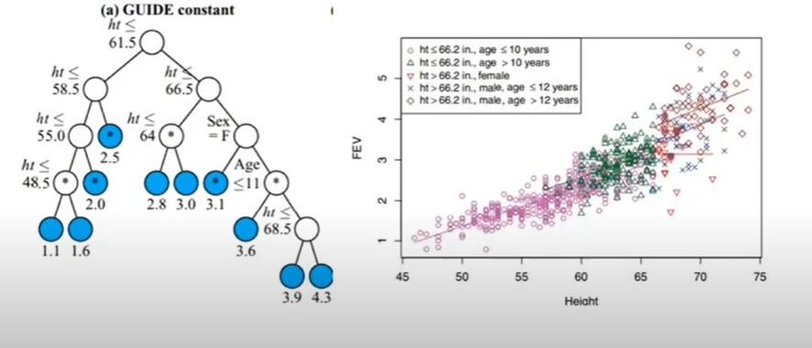
Example 3:

Slide 5
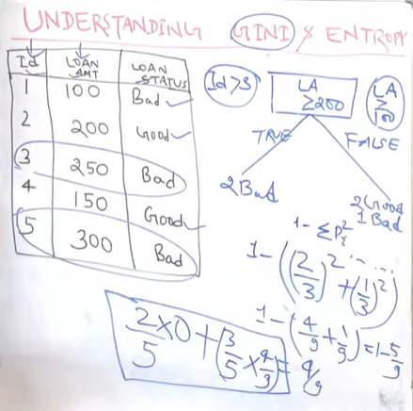
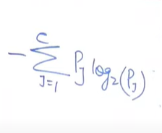
How to choose the root node?
“gini” → faster
“entropy”

Slide 6
Some Terminologies:
max_depth
min_samples_split
max_features
fit(X)
predict(X)
score(X)

Slide 7
Let’s Code!

Slide 8
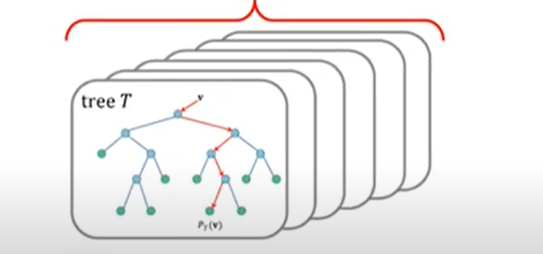
Random Forest

Slide 9
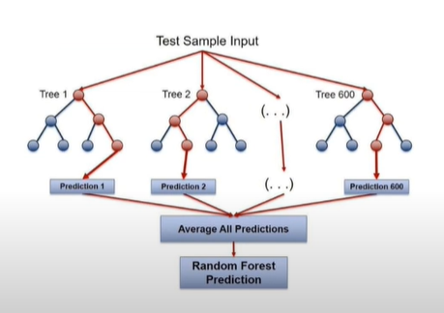
Example:

Slide 10
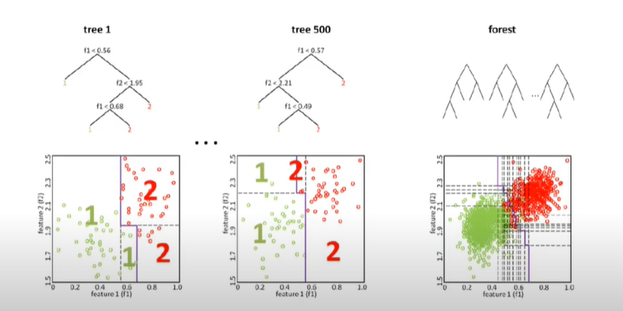
Example:

Slide 11
Some Terminologies:
n_estimators
max_depth
min_samples_split
max_features
fit(X)
predict(X)
score(X)

Slide 12
Let’s Code!

